Slide 1
Math 152
Lesson | Topic | Reading
29 | Absolute Convergence, Ratio & Root Tests | 11.6
30 | Power Series/Representation of Functions as Power Series | 11.8/11.9
31 | Taylor and Maclaurin Series | 11.10
Objectives:
Identify what makes a series a "power series"
Calculate interval and radius of convergence for given series
Develop POWER SERIES expansion for applicable functions
Use differentiation, integration, and known power series to calculate power series expansions of given functions

Slide 2
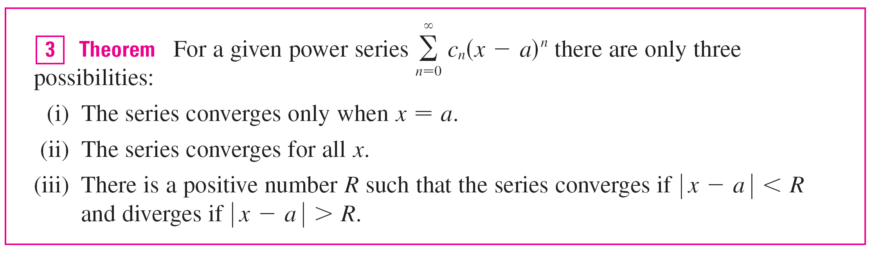


Power Series
General Form:
The number R in case (iii) is called the radius of convergence of the power series. By convention, the radius of convergence is R = 0 in case (i) and R = in case (ii).

Slide 3
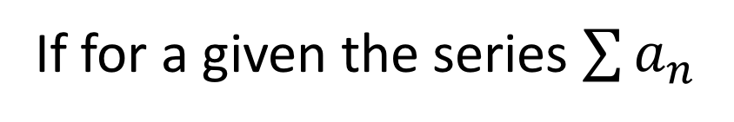
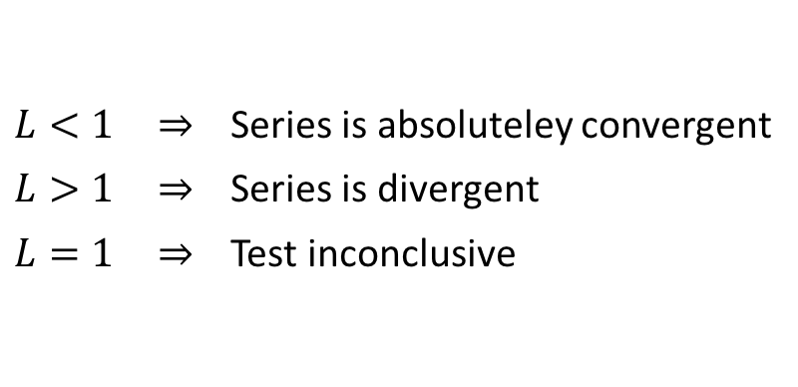
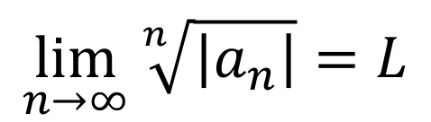
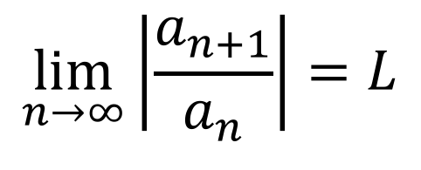
The Ratio & Root Tests
For power series, typically use Ratio Test, but Root Test can also be useful sometimes
If for a given the series $\sum{a_{n}}$
$$\lim_{n→∞}\left|\frac{a_{n+1}}{a_{n}}\right|=L$$
OR
$$\lim_{n→∞}{\sqrt[n]{\left|a_{n}\right|}}=L$$
$L<1 \overset{⇒}{}$ Series is absoluteley convergent
$L>1 \overset{⇒}{}$ Series is divergent
$L=1 \overset{⇒}{}$ Test inconclusive
Once you determine the interval of convergence, you need to test the end points

Slide 4
Example
What is the radius of convergence and the interval of convergence for:

Slide 5
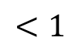
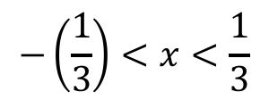

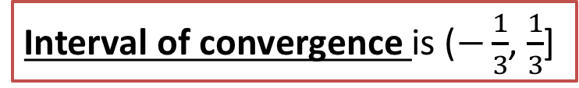
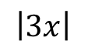
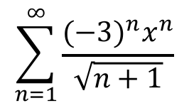
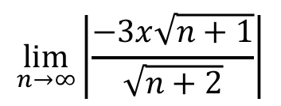
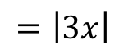
Example
$$\sum_{n=1}^{∞}{\frac{{(−3)}^{n}x^{n}}{\sqrt{n+1}}}$$
$$\lim_{n→∞}\left|\frac{−3x\sqrt{n+1}}{\sqrt{n+2}}\right|$$
$$=\left|3x\right|$$
Converges when
$$\left|3x\right|$$
$$<1$$
$$−\left(\frac{1}{3}\right)<x<\frac{1}{3}$$
Radius of convergence of $\frac{1}{3}$ centered at 0
Interval of convergence is ($−\frac{1}{3}$, $\frac{1}{3}$]
Notes:
Example on page 744, p745 #2 (assigned) asks for the definition of RoC…prob’ly oughta know it
${(−3)}^{n}{(−\frac{1}{3})}^{n}$ = ${(3/3)}^{n}$ = ${\left(1\right)}^{n}{ =1 (−3)}^{n}{(\frac{1}{3})}^{n}$ = ${(−3/3)}^{n}$ = ${(−1)}^{n}$
diverges: $\lim_{n→∞}{\frac{a_{n}}{b_{n}}}=c$ converges by alternating series test (i & ii)
$a_{n}$ = 1/(n+1)^(1/2), $b_{n}$ = 1/n^(1/2)
divergent (p<1) p-series
$\lim_{n→∞}{\frac{a_{n}}{b_{n}}}=c$ = 1, therefore, BOTH diverge
In the LIMIT COMPARRISON TEST (RATIO), $\lim_{n→∞}\left|\frac{a_{n+1}}{a_{n}}\right|=L$ = 1 (inconclusive…not absolutely convergent)
P743
For a given series, $\sum_{n=0}^{∞}{c_{n}{\left(x−a\right)}^{n}}:$
The series converges ONLY when x = a
The series converges for ALL x (ie, if the outcome of solving the inequality is , ie, “1/2 < 1”…it is true for ALL x
There is a positive number R such that the series converges if “$\left|x −a\right|<R", and$
diverges if “$\left|x −a\right|>R",$
Where R is the radius of convergence

Slide 6
Differentiation &Integration of Power Series

Slide 7
Example
The Bessel function
is defined for all x (i.e., continuous)
Thus, by Theorem 2, J₀ is differentiable for all x and its derivative is found by term-by-term differentiation as follows:

Slide 8
Desk Work
Find the radius and interval of convergence:
Hint: use the Ratio Test, then check the end points

Slide 9
Desk Work

Slide 10
Desk Work

Slide 11
Desk Work

Slide 12
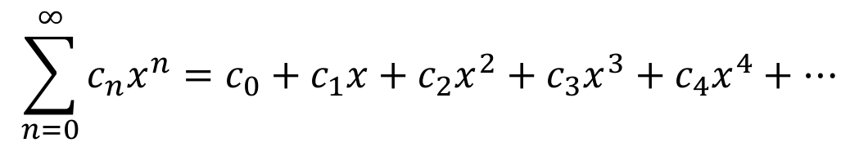
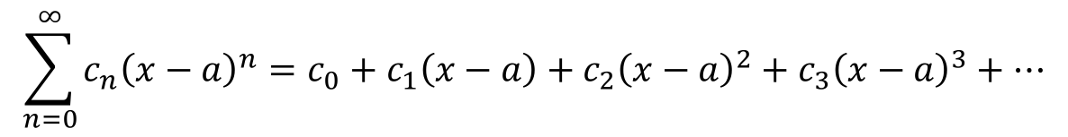
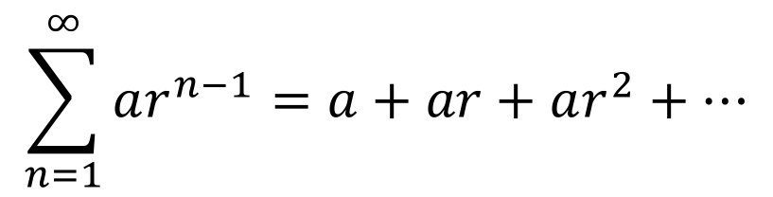
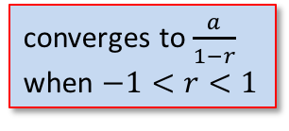
Functions as Power Series
$$\sum_{n=0}^{∞}{c_{n}{\left(x−a\right)}^{n}}=c_{0}+c_{1}\left(x−a\right)+c_{2}{\left(x−a\right)}^{2}+c_{3}{\left(x−a\right)}^{3}+⋯$$
$$\sum_{n=0}^{∞}{c_{n}x^{n}}=c_{0}+c_{1}x+c_{2}x^{2}+c_{3}x^{3}+c_{4}x^{4}+⋯$$
where a=0
Geometric Series:
$$\sum_{n=1}^{∞}{ar^{n−1}}=a+ar+ar^{2}+⋯$$
converges to $\frac{a}{1−r}$ when $−1<r<1$
where c_{n} = a and r = x
Notes:
The constant “a” is now replaced by the series $\sum_{n=0}^{∞}{c_{n}}$, and “$r^{n}$” is replaced by “$x^{n}$”
Replacing “x” with “x – a” is just a shift “a” units to the right

Slide 13
Example
Express 1/(1 + x²) as the sum of a power series and find the interval of convergence.
Solution:
Replacing x by –x² in Equation 1, we have

Slide 14
Example
Because this is a geometric series, it converges when
| –x² | < 1, that is, x² < 1, or | x | < 1.
Therefore the interval of convergence is (–1, 1). (Of course, we could have determined the radius of convergence by applying the Ratio Test, but that much work is unnecessary here.)

Slide 15
Backups

Slide 16
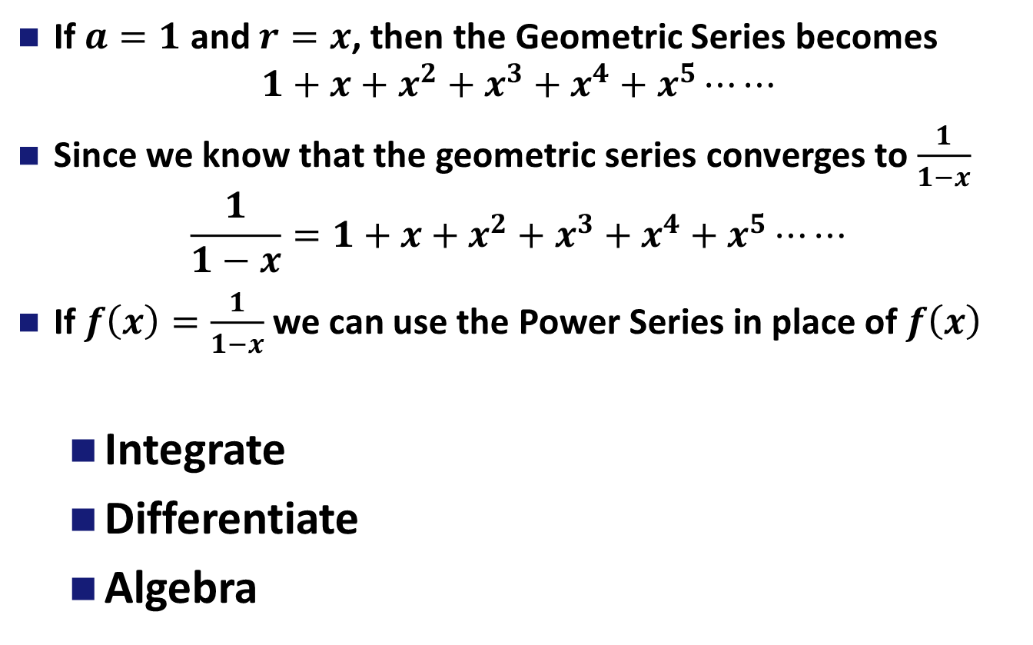
Representing a Function as a Power Series
If $a=1$ and $r=x$, then the Geometric Series becomes
$$1+x+x^{2}+x^{3}+x^{4}+x^{5}⋯⋯$$
Since we know that the geometric series converges to $\frac{1}{1−x}$
$$\frac{1}{1−x}=1+x+x^{2}+x^{3}+x^{4}+x^{5}⋯⋯$$
If $f\left(x\right)=\frac{1}{1−x}$ we can use the Power Series in place of $f\left(x\right)$
Integrate
Differentiate
Algebra
Notes:
Geometric series, where a = 1, and r = x
Ask for radius of convergence

Slide 17

Power Series
A power series is a series of the form
where x is a variable and the c_{n}’s are constants called the coefficients of the series.
For each fixed x, the series is a series of constants that we can test for convergence or divergence.
A power series may converge for some values of x and diverge for other values of x.

Slide 18
Power Series
The sum of the series is a function
f (x) = c₀ + c₁x + c₂x² + . . . + c_{n}x^{n} + . . .
whose domain is the set of all x for which the series converges. Notice that f resembles a polynomial. The only difference is that f has infinitely many terms.
For instance, if we take c_{n} = 1 for all n, the power series becomes the geometric series
x^{n} = 1 + x + x² + . . . + x^{n} + . . .
which converges when –1 < x < 1 and diverges when| x | ≥ 1.

Slide 19
Power Series
More generally, a series of the form
is called a power series in (x – a) or a power series centered at a or a power series about a.
Notice that in writing out the term corresponding to n = 0 in Equations 1 and 2 we have adopted the convention that (x – a)⁰ = 1 even when x = a.
Notice also that when x = a all of the terms are 0 for n ≥ 1 and so the power series always converges when x = a.

Slide 20
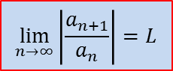
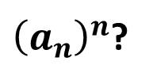
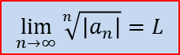
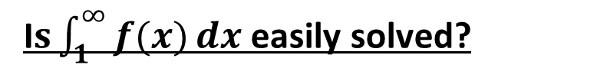
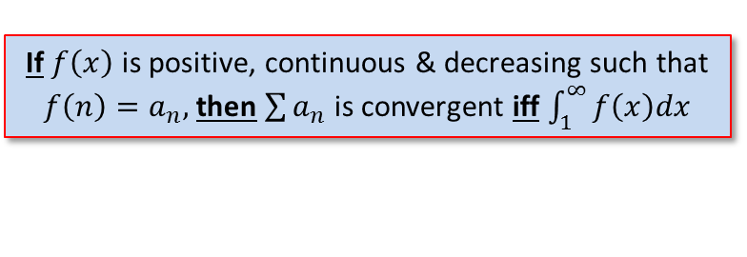
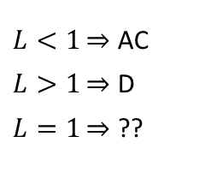
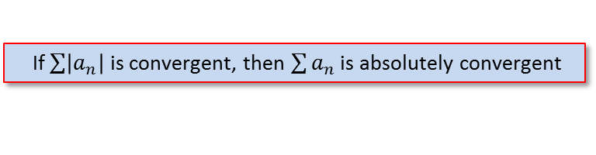
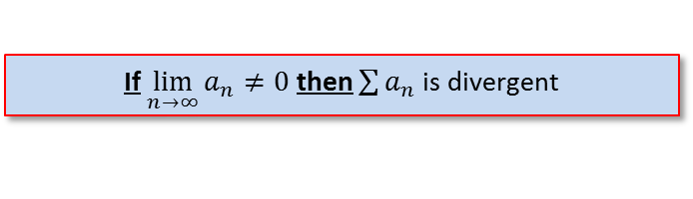
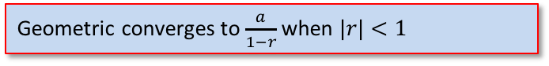

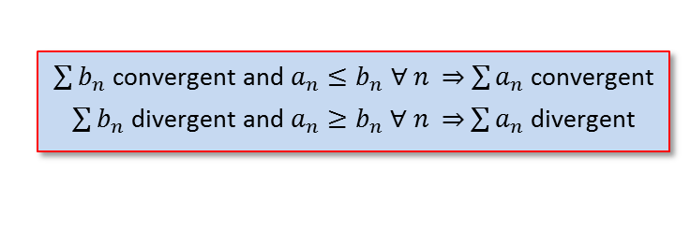
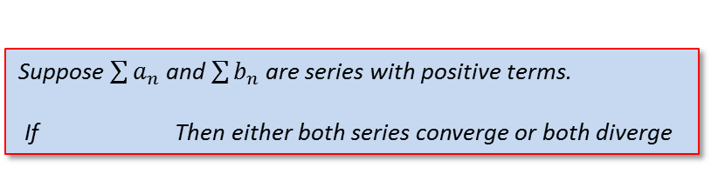
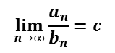
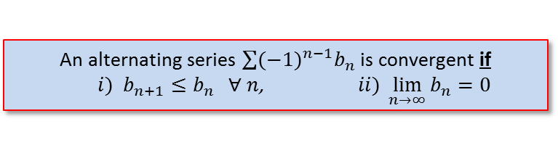
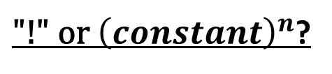
Strategy for Testing Series
Test for Divergence
If $\lim_{n→∞}{a_{n}≠0}$ then $\sum{a_{n}}$ is divergent
geometric-series?
Geometric converges to $\frac{a}{1−r}$ when $|r|<1$
p-series?
$p$-series converges when $p>1$
“like” a g- or p-series?
Comparison Test
$\sum{b_{n}}$ convergent and $a_{n}≤b_{n}$ $∀$ $n$ $\sum{a_{n}}$ convergent
$\sum{b_{n}}$ divergent and $a_{n}≥b_{n}$ $∀$ $n$ $\sum{a_{n}}$ divergent
Limit Comparison Test
Suppose $\sum{a_{n}}$ and $\sum{b_{n}}$ are series with positive terms.
If Then either both series converge or both diverge
$$\lim_{n→∞}{\frac{a_{n}}{b_{n}}}=c$$
Alternating Series?
An alternating series $\sum{{(−1)}^{n−1}b_{n}}$ is convergent if
$i) b_{n+1}≤b_{n} ∀ n$, $ii) \lim_{n→∞}{b_{n}=0}$
If $\sum{\left|a_{n}\right|}$ is convergent, then $\sum{a_{n}}$ is absolutely convergent
$L<1\overset{⇒}{}$ AC
$L>1\overset{⇒}{}$ D
$L=1\overset{⇒}{}$ ??
${\text{"!" }\text{or} \left(constant\right)}^{n}$?
$$\lim_{n→∞}\left|\frac{a_{n+1}}{a_{n}}\right|=L$$
${\left(a_{n}\right)}^{n}$?
$$\lim_{n→∞}{\sqrt[n]{\left|a_{n}\right|}}=L$$
I$s\int_{1}^{∞}{f(x)}dx$ easily solved?
If $f\left(x\right)$ is positive, continuous & decreasing such that $f\left(n\right)=a_{n},$then$\sum{a_{n}}$ is convergent iff $\int_{1}^{∞}{f\left(x\right)dx}$
Notes:
Section 11.7, p739
Comparison test: if the term is a rational function or an algebraic function of n (involving roots of polynomials), then the series should be compared with a p-series, keeping only the highest powers of n in the numerator & denominator
Ratio & Root test: inconclusive if L = 1, or DNE

Slide 21
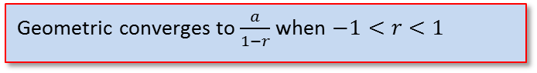
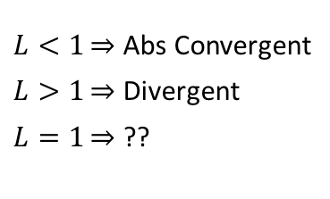
Alt/Ratio Test
$\sum{\frac{n}{{\left(−2\right)}^{n}}}$ =
$\sum{\frac{{\left(−2\right)}^{n}}{n^{}}}$ =
Alternating Series?
An alternating series $\sum{{(−1)}^{n−1}b_{n}}$ is convergent if
$i) b_{n+1}≤b_{n} ∀ n$, $ii) \lim_{n→∞}{b_{n}=0}$
$L<1\overset{⇒}{}$ Abs Convergent
$L>1\overset{⇒}{}$ Divergent
$L=1\overset{⇒}{}$ ??
Ratio Test?
$$\lim_{n→∞}\left|\frac{a_{n+1}}{a_{n}}\right|=L$$
Notes:
They are alternating, but i) and ii) are not really easy to do
Try the LCT… c = ½ <1 c = 2 > 1

Slide 22
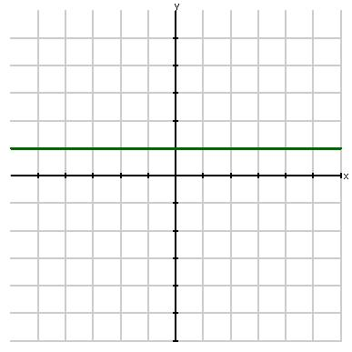
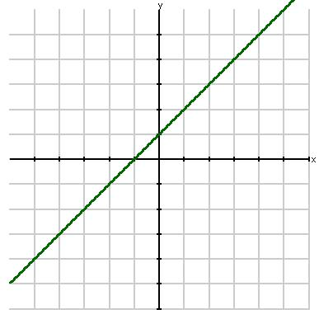
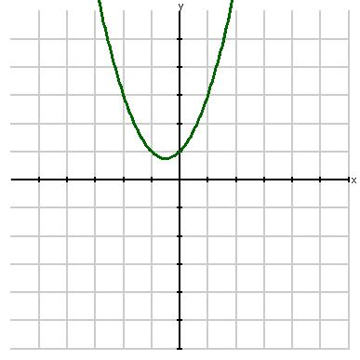
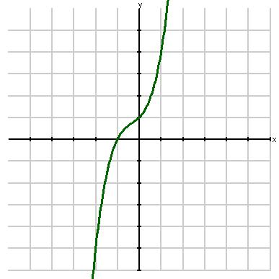
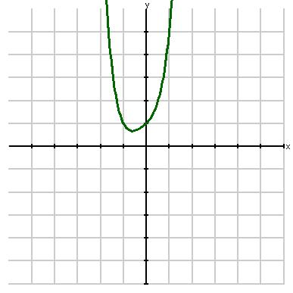
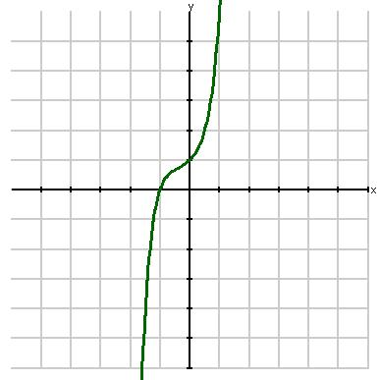
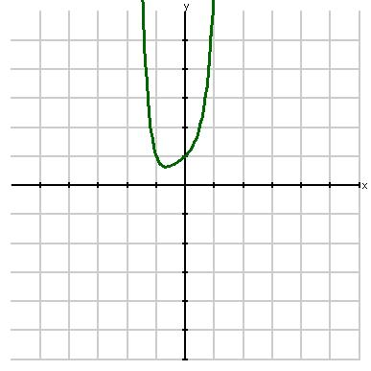
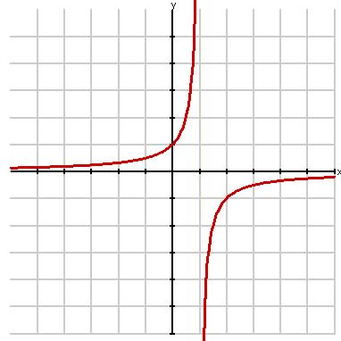
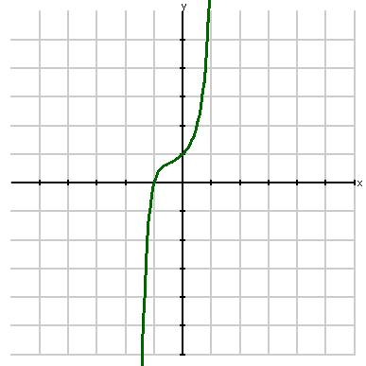
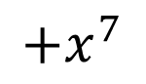
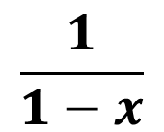

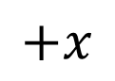
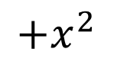
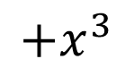
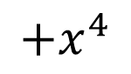
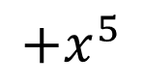
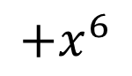
$$\frac{1}{1−x}$$
$$1$$
$$+x$$
$$+x^{2}$$
$$+x^{3}$$
$$+x^{4}$$
$$+x^{5}$$
$$+x^{6}$$
$$+x^{7}$$
Notes:
1+x^1+x^2+x^3+x^4+x^5+x^6+x^7+x^8+x^9+x^10+x^11+x^12

